Slide 1
Pleasure without end,
To find wherever one looks,
It is not hard to find,
And it always has a red light,
The light shows the way,
But never the consequences.
Lust
LUST
Pleasure without end,
To find wherever one looks,
It is not hard to find,
And it always has a red light,
The light shows the way,
But never the consequences.

Slide 2
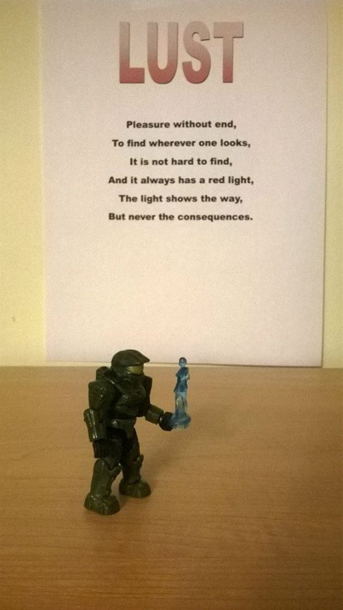

Slide 3
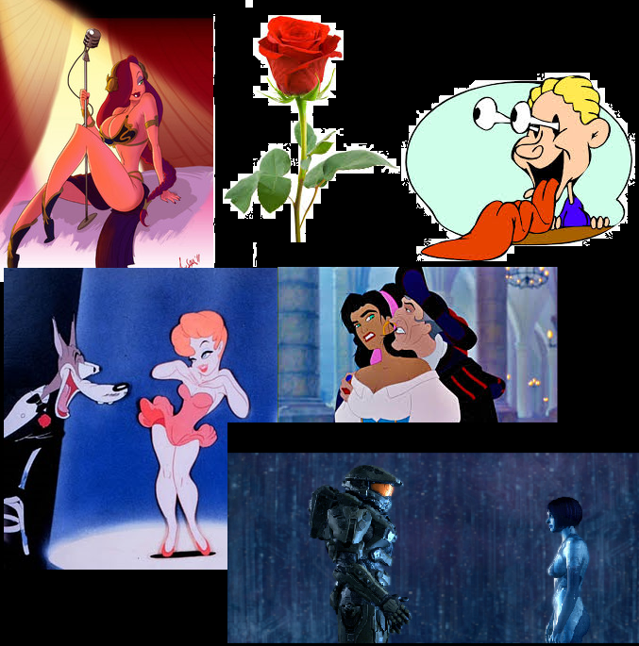

Slide 4
Sloth
Sloth is boring,
Living day to day,
Not doing anything,
Laying about not trying,
To move would,
Just be hurtful.

Slide 5
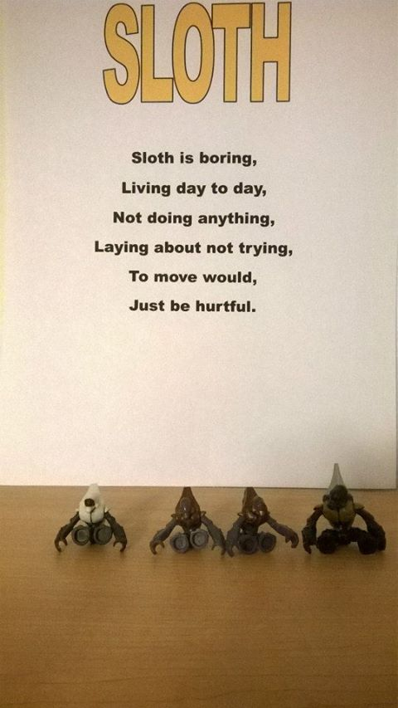

Slide 6
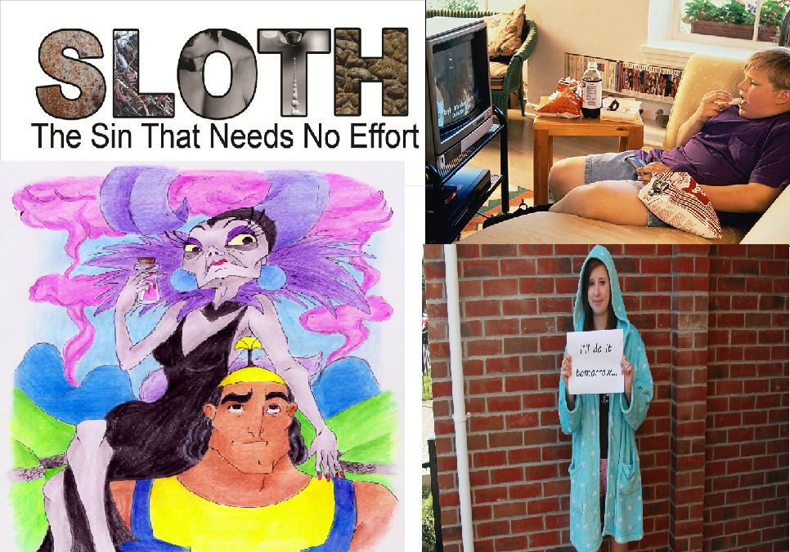

Slide 7
$ GREED $
I want it all and get it all,
The job I have makes me a billionaire,
As long as the product I make is toxic,
I accept bribes three times larger,
Than those that I give,
I care not for the poor work conditions,
As long as the product gets done,
My fortune is built on the graves of others,
I do not care as long as I get what’s mineS

Slide 8
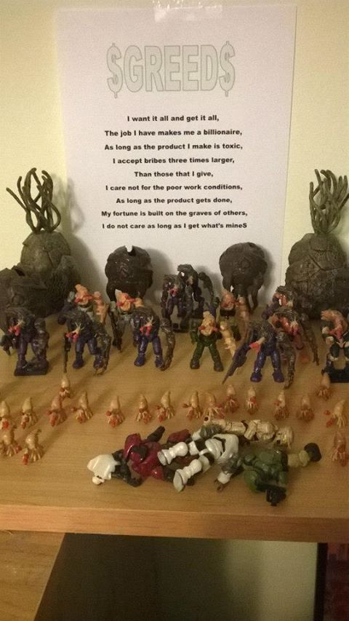

Slide 9
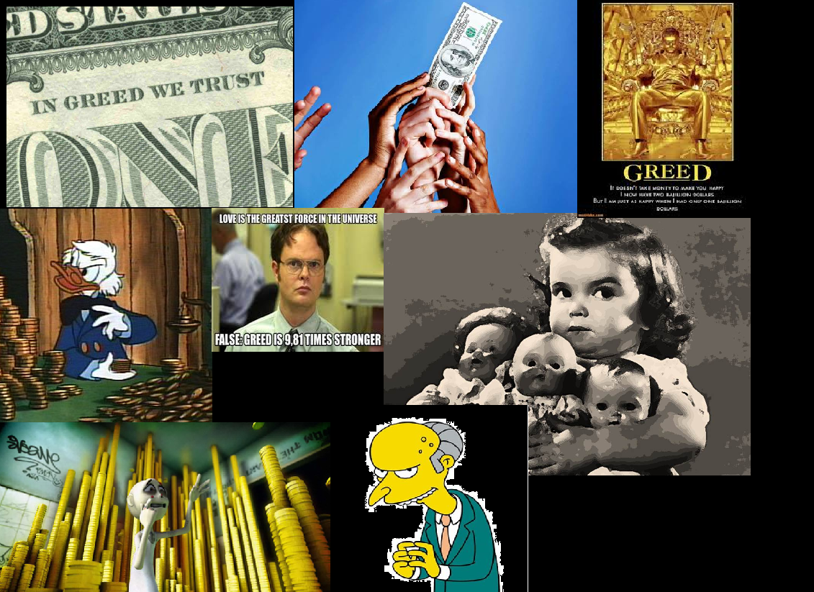

Slide 10
GLUTTONY
Gluttony is constantly growing
My body is growing
Wider and wider
With the idea of exercise
Far from my mind
With only the bowl only coming
closer….

Slide 11
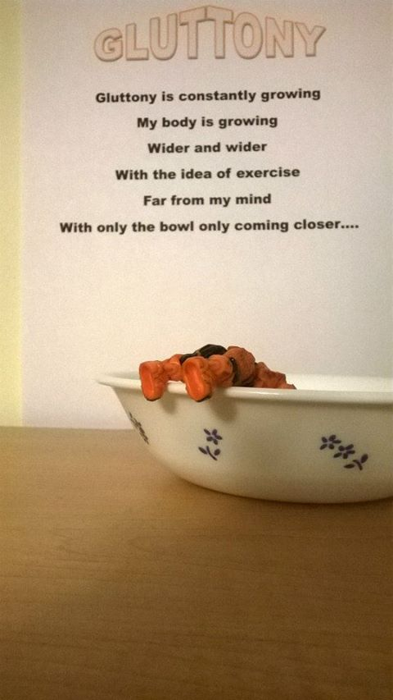

Slide 12
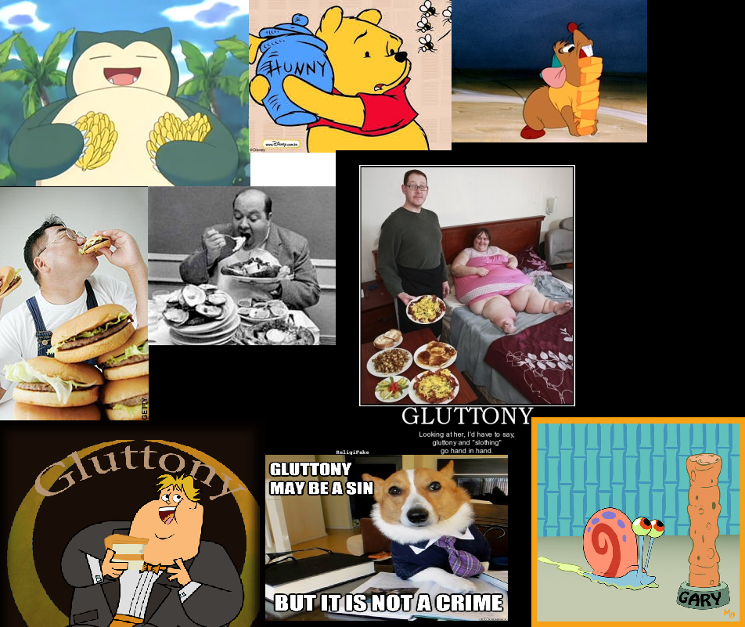

Slide 13
PRIDE
I am proud of my perfection,
I love my reflection,
More than my wife,
I have three children,
But they pale in comparison to me,
I have done it all myself,
and I do not mind telling others,
I am the smartest,
Most brilliant,
Beyond compare to anyone else,
I am the perfection that everyone should strive for.

Slide 14
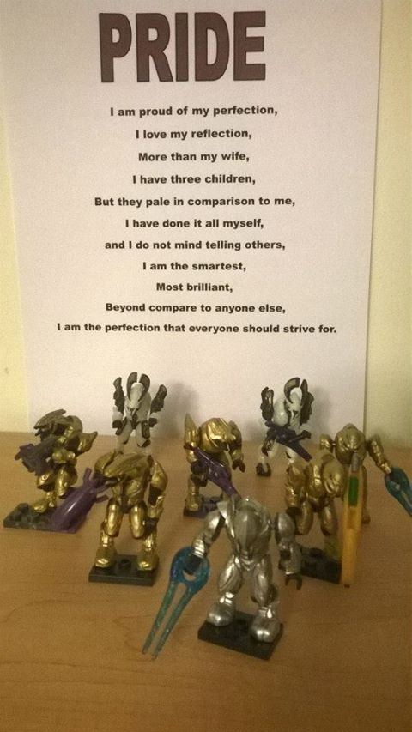

Slide 15
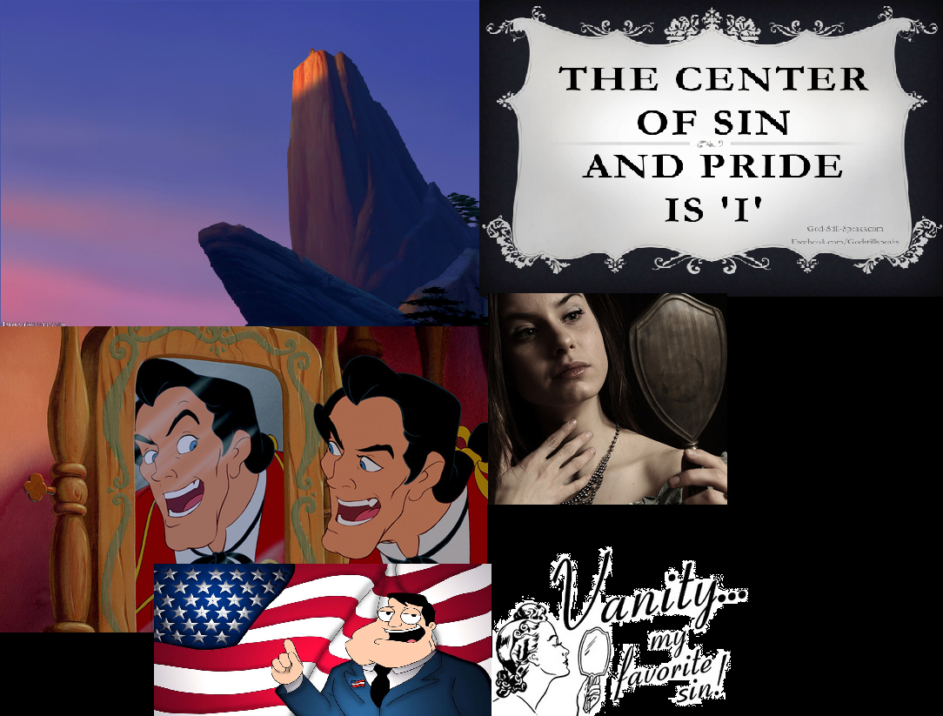

Slide 16
WRATH
Wrath is what I love the most,
Being able to hate without end,
And hate indiscriminately,
Racism and classism,
People hating others,
Never forgiving,
Always growing and never forgiving,
Hate will be all consuming,
And will always be a terror.

Slide 17
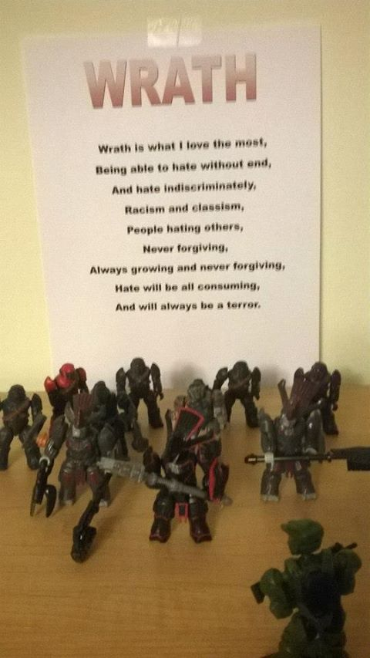

Slide 18
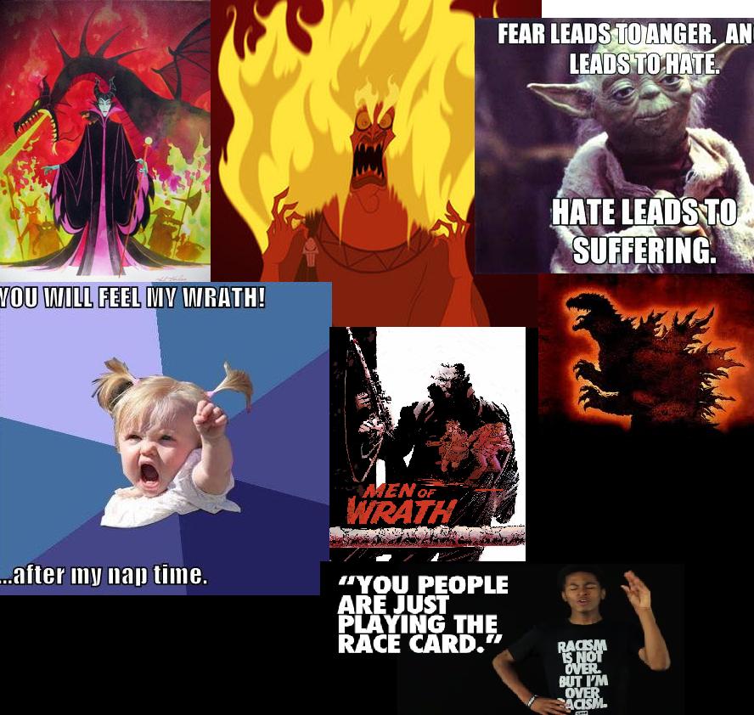

Slide 19
ENVY
Envy is what I what never have
That new car,
That solid gold toilet,
That job where he doesn’t work,
His family that he has,
His fame and his glory,
He has what I want.

Slide 20
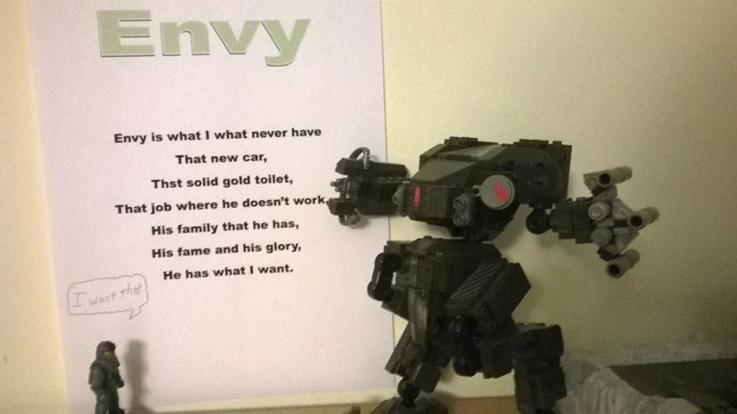

Slide 21
